Slide 1
The effect of shall laws on crime rate.

Slide 2
Agenda
Introduction
Data Exploration
Data Modeling
Summary

Slide 3
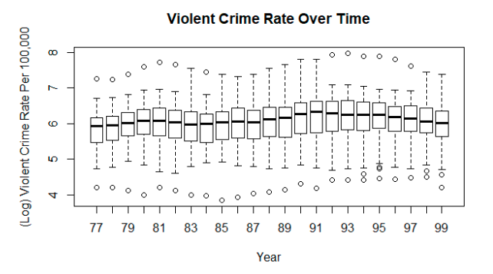
Trends Over Time
Notes:
showing the outliers of each crime rate for each period of time
We can see that there are outliers both above and below the quartile of log(violent crime rate). There also seems to be a slight increase in violent crime rate over time.

Slide 4
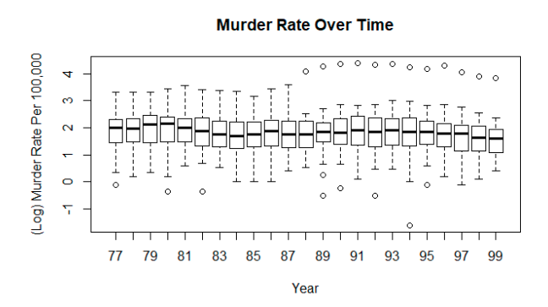
Trends Over Time
Notes:
Once again there are a few outliers above and below the quartiles of log(murder rate). Murder rate also seems to have slightly decreased over time.

Slide 5
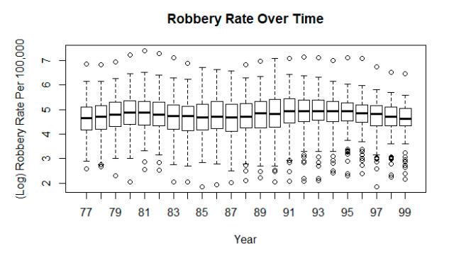
Trends Over Time
Notes:
There are many outliers in robbery rate, especially after 1987. This is important to note, as this could heavily skew any results or insights we receive from robbery rate models. There also seems to be a slight decrease in robbery rate over time.

Slide 6
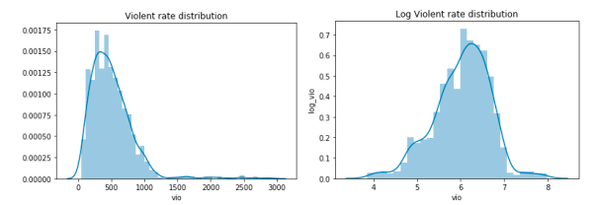
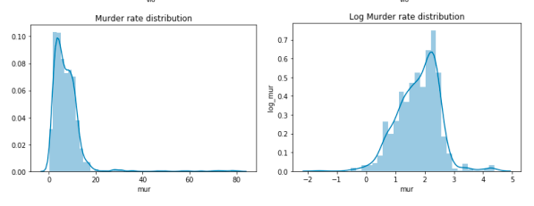
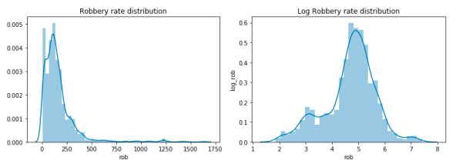
Distribution of violent, murder, and robbery rate
Notes:
It is clearly seen that the distribution of violent rate, murder rate, and robbery rate are highly skewed to the right on the graphs above. Therefore, we transform them using natural logs to have a more normal distribution. By doing so, we can reduce the influence of outliers on the model, and thus have a more accurate model. The graphs of the transformed rates can be found on the right side of the graphs above.

Slide 7
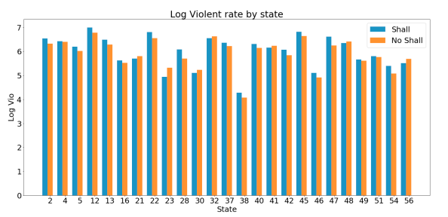
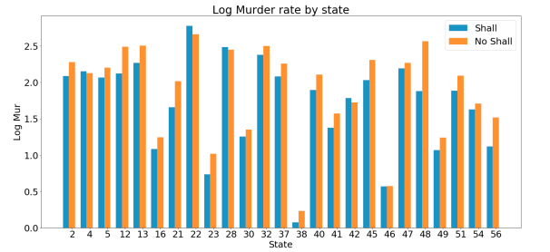
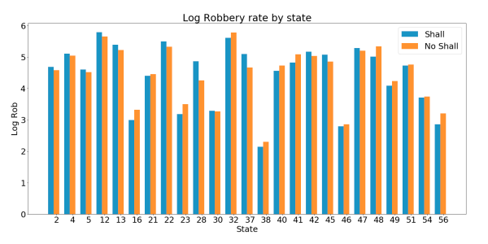
Distribution of Violent, Murder, Robbery Rate by State
Notes:
The graphs above compare the average log violent rate, log murder rate, and log robbery state by each state and by whether shall law was passed or not. Because it compares also withinstate rates by whether shall law was passed or not, only 25 out of 51 states are included in these graphs. We can see that in the graph of log violent rate, the rate when shall law was passed is higher than when shall law was not passed in the majority of the states. On the other hand, the log murder rate is much higher when shall law was not passed compared to when it is passed in the majority of the states. Last but not least, there is no clear trend in the effect of shall law on log robbery rate, as the rate is higher than when it is not passed in some states and lower in other states. There is a trend however that is more observable in states that either had Shall before 1977 or never had Shall until 1999. Observing these trends would suggest the use of both fixed effects and time fixed-effect models would be appropriate

Slide 8
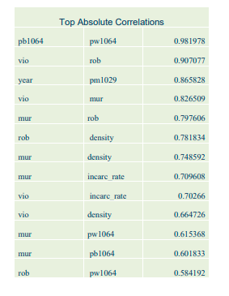
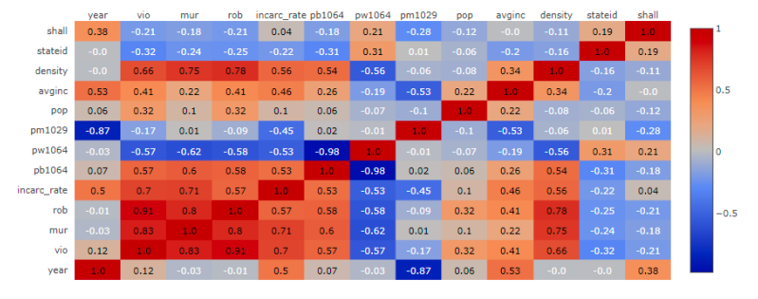
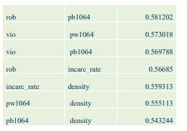
Correlation matrix

Slide 9
Walds Test
The Wald test is frequently used to compare the differences between nested models.
One model is considered nested in another if the first model can be generated by imposing restrictions on the parameters of the second. Most often, the restriction is that the parameter is equal to zero. In a regression model restricting a parameters to zero is accomplished by removing the predictor variables from the model
The Walds test ask the same basic question, which is, does constraining these parameters to zero (i.e., leaving out these predictor variables) significantly reduce the fit of the model?

Slide 10
Walds Test
The Wald test works by testing that the parameters of interest are simultaneously equal to zero. If they are, this strongly suggests that removing them from the model will not substantially reduce the fit of that model, since a predictor whose coefficient is very small relative to its standard error is generally not doing much to help predict the dependent variable.

Slide 11
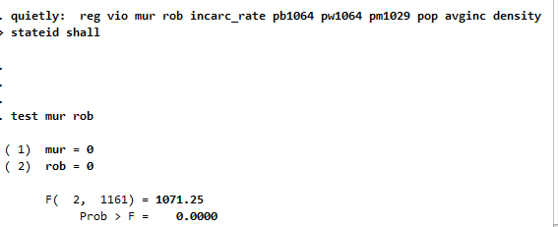
Walds Test
The code we used -
OUTPUT
quietly: reg vio mur rob incarc_rate pb1064 pw1064 pm1029 pop avginc density stateid shall
test mur rob

Slide 12
Walds Test
Explanation -
The first line of syntax below does this (but uses the quietly prefix so that the output from the regression is not shown). The second line of syntax below instructs Stata to run a Wald test in order to test whether the coefficients for the variables mur and rob are simultaneously equal to zero. The output first gives the null hypothesis.
Below that we see the F-test value generated by the Wald test, as well as the p-value associated with a F-test of 1071.25 with two degrees of freedom. Based on the p-value, we can reject the null hypothesis, again indicating that the coefficients for mur and rob are not simultaneously equal to zero, meaning that including these variables create a statistically significant improvement in the fit of the model.

Slide 13
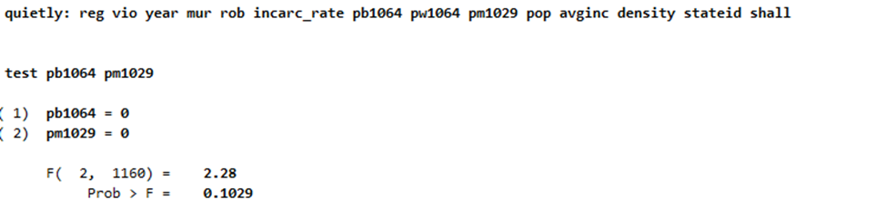
Walds Test
The code we used -
OUTPUT
quietly: reg vio mur rob incarc_rate pb1064 pw1064 pm1029 pop avginc density stateid shall
test pb1064 pm1029

Slide 14
Walds Test
Explanation -
The first line of syntax below does this (but uses the quietly prefix so that the output from the regression is not shown). The second line of syntax below instructs Stata to run a Wald test in order to test whether the coefficients for the variables pb1064 and pm1029 are simultaneously equal to zero. The output first gives the null hypothesis.
Below that we see the F-test value generated by the Wald test, as well as the p-value associated with a F-test of 2.28 with two degrees of freedom. Based on the p-value, we cannot reject the null hypothesis. So, we need to remove either of variable in model.

Slide 15
Summary

Slide 16
Fixed Effects Model
The fixed effects regression model is used to estimate the effect of variables that vary over time in a panel data set.
The objective of including a fixed effects model is to understand if time-invariant characteristics of individual state affect the regression.

Slide 17
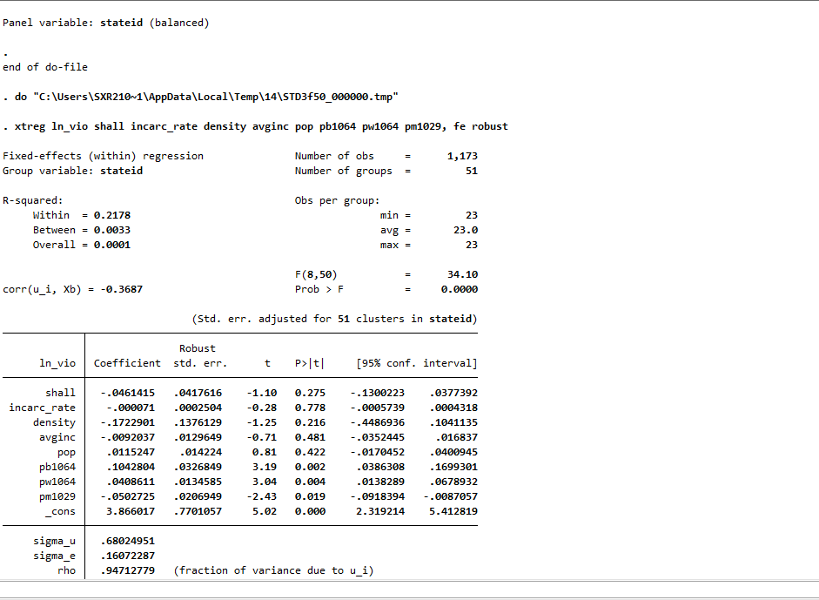
Fixed Effects test
The code we used -
OUTPUT
xtset state
We saved our dataset as state, and converted it into a balanced panel dataset
xtreg ln_vio shall incarc_rate density avginc pop pb1064 pw1064 pm1029, fe robust

Slide 18
Fixed Effects Interpretation
The results of the fixed effects of the model change when we add fixed effects of states.
The absolute value of the coefficient on shall reduce to 0.046, compared to 0.369 without fixed effects.
We also understand that the effect of shall laws on the violent crime rate is no longer statistically significant.

Slide 19
Fixed Effects Summary
There was an important omitted variable bias in the equation without fixed effects.
We also understand that the regression model with fixed effects is better because it controls for unobservable characteristics which may depend on individual state characteristics but are constant over time.

Slide 20
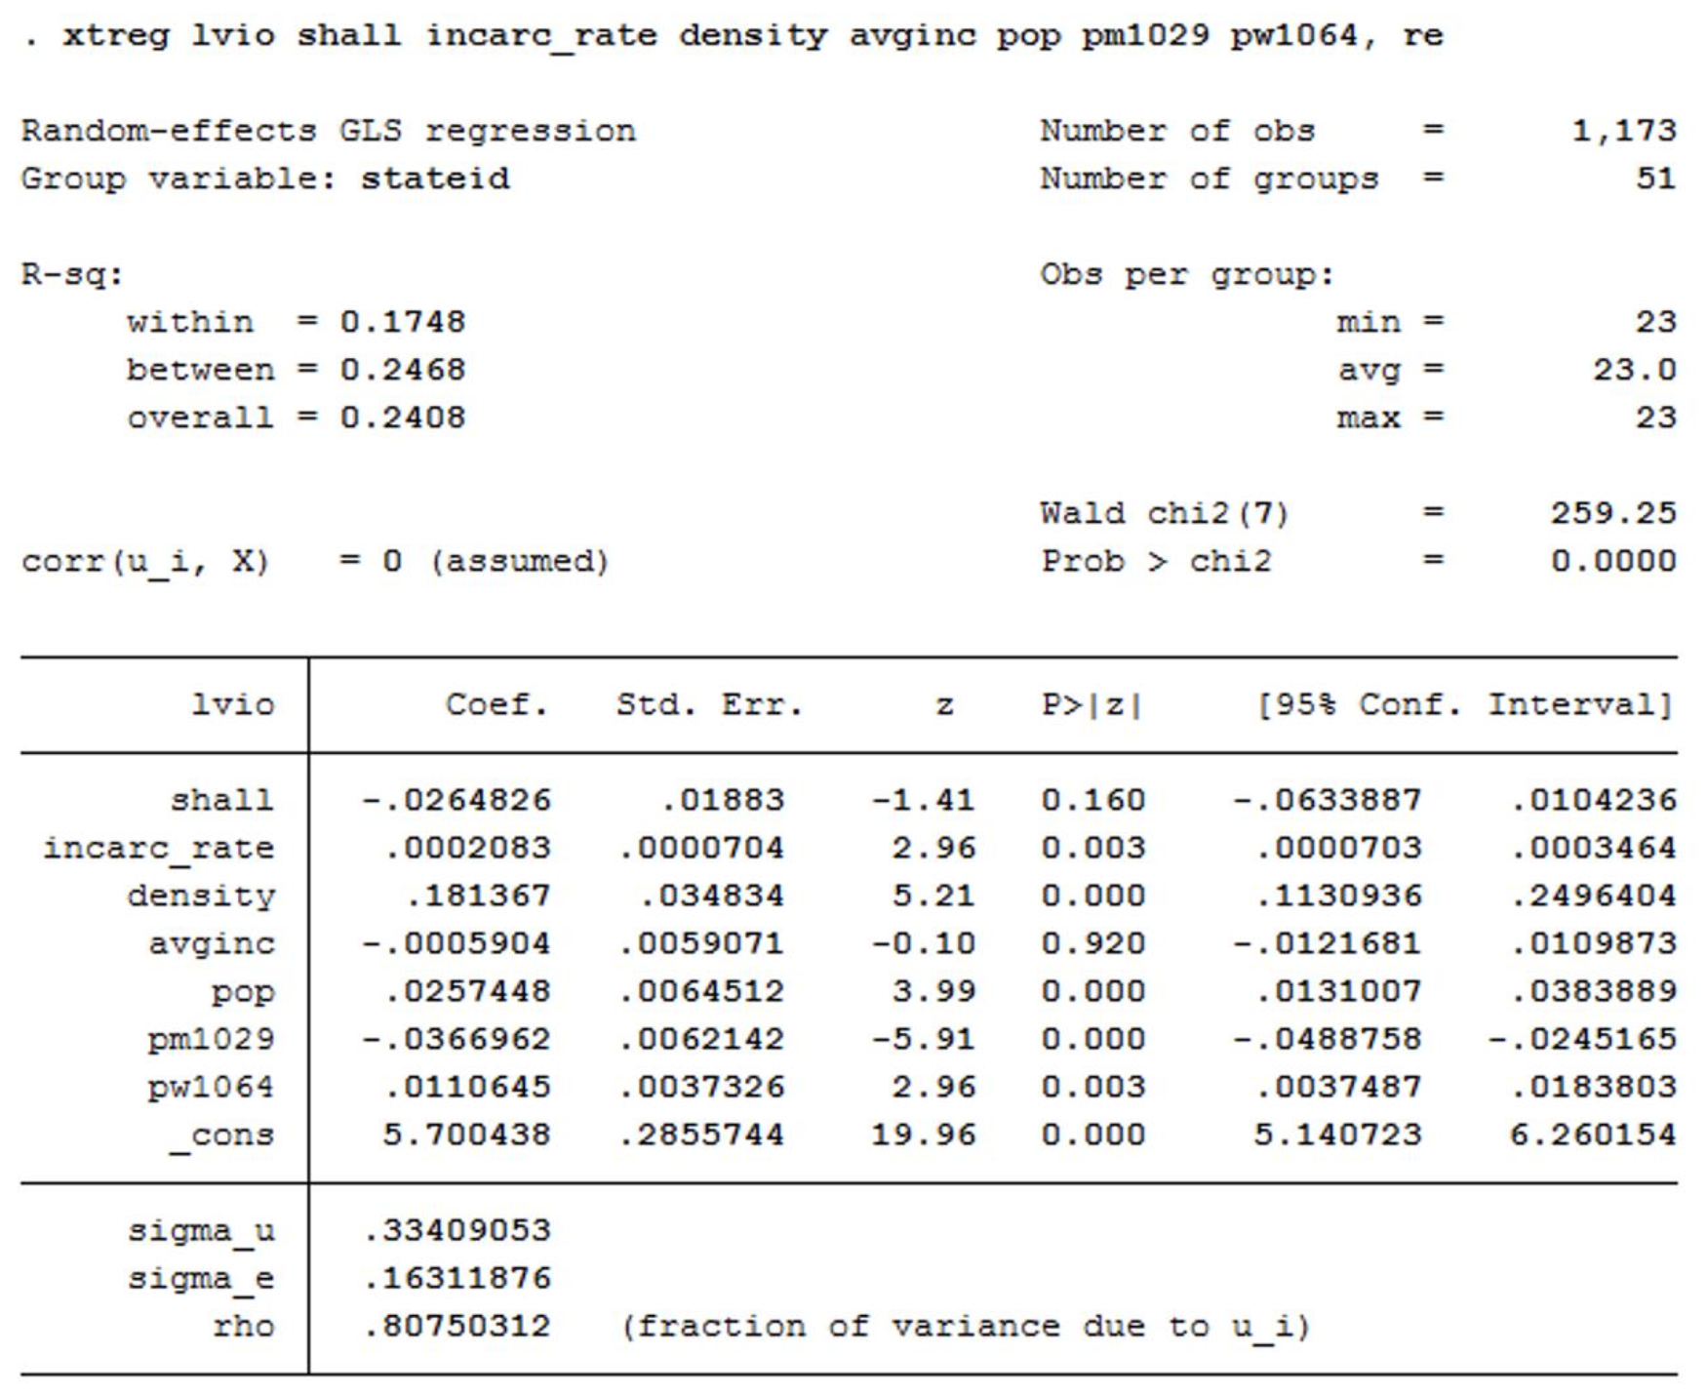
Random Effects Model for violent variable
OUTPUT
The code we used
﻿/* Random effects model */
xtreg lvio shall incarc_rate density avginc pop pm1029 pw1064, re
﻿Although we believe a random effects model will not be appropriate in this case (because the
data set is not from a random sampling process), we still run a random effects model and
perform a Hausman test to further support our argument.

Slide 21
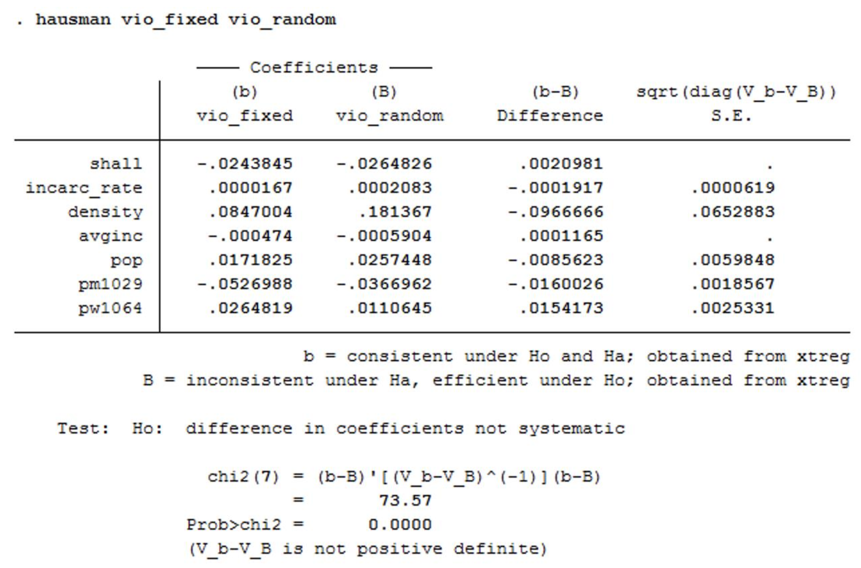
Hausman test for violent variable
The code we used
OUTPUT
/* Hausman test */
xtreg lvio shall incarc_rate density avginc pop pm1029 pw1064, fe
estimates store vio_fixed
xtreg lvio shall incarc_rate density avginc pop pm1029 pw1064, re
estimates store vio_random
hausman vio_fixed vio_random
﻿According to the Hausman test, the null hypothesis will be that there is no correlation between the explanatory variables and the error terms. With the p-value = 0.0000, we will reject the null hypothesis and conclude that there is a correlation between the explanatory variables and the error terms. Therefore, the estimates derived from the random-effects model will be biased and inconsistent, and thus, fixed effects model will be the better model in this case. This is on the same line with our argument in the previous part.

Slide 22
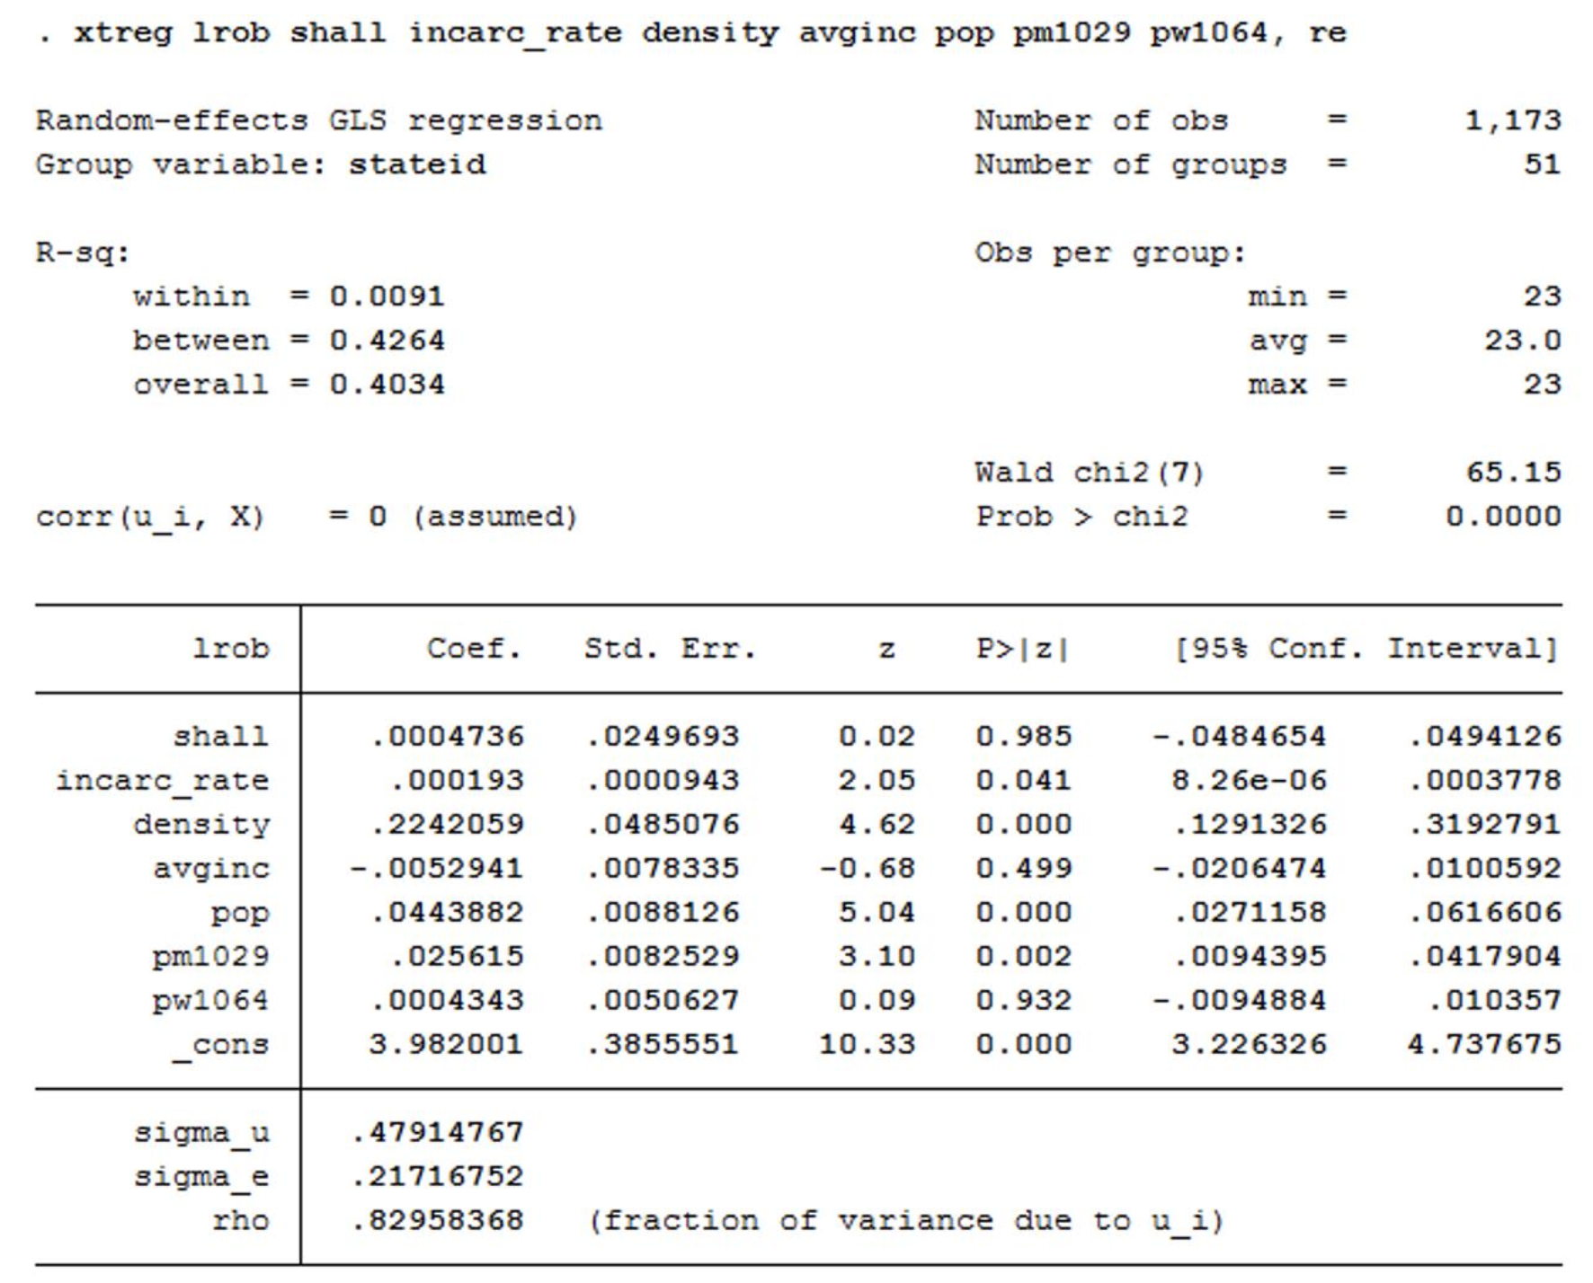
Random Effects Model for robbery variable
OUTPUT
The code we used
﻿/* Random effects model */
xtreg lrob shall incarc_rate density avginc pop pm1029 pw1064, re

Slide 23
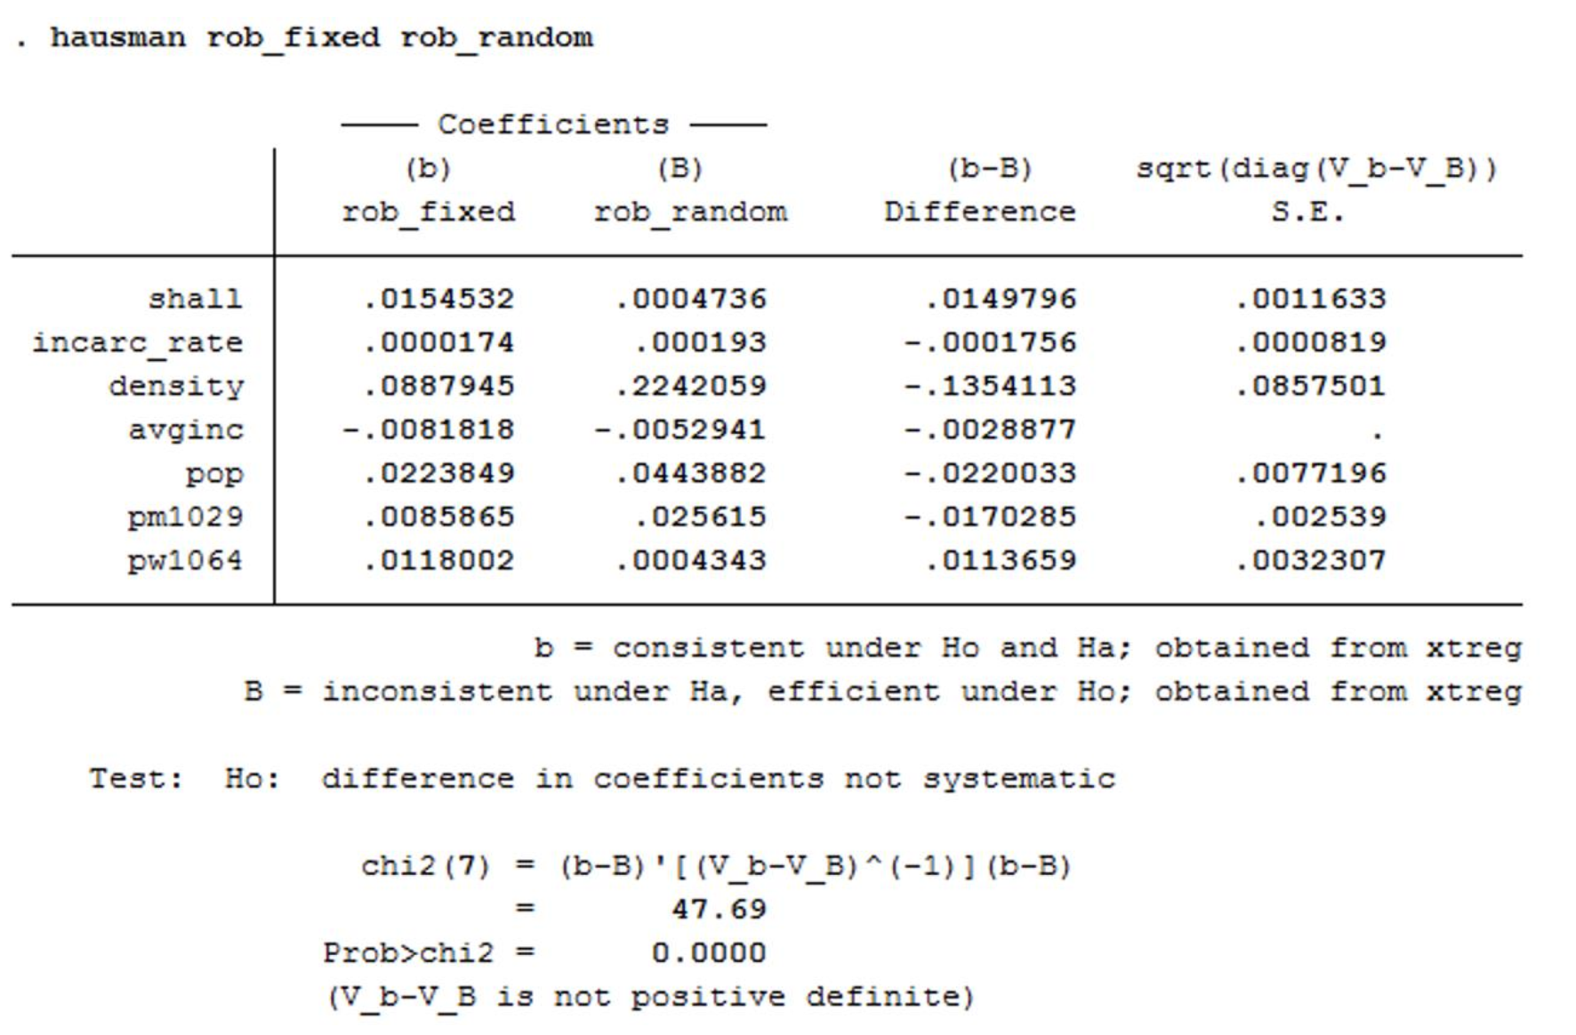
Hausman test for robbery variable
OUTPUT
The code we used
/* Hausman test */
xtreg lrob shall incarc_rate density avginc pop pm1029 pw1064, fe
estimates store rob_fixed
xtreg lrob shall incarc_rate density avginc pop pm1029 pw1064, re
estimates store rob_random
hausman rob_fixed rob_random

Slide 24
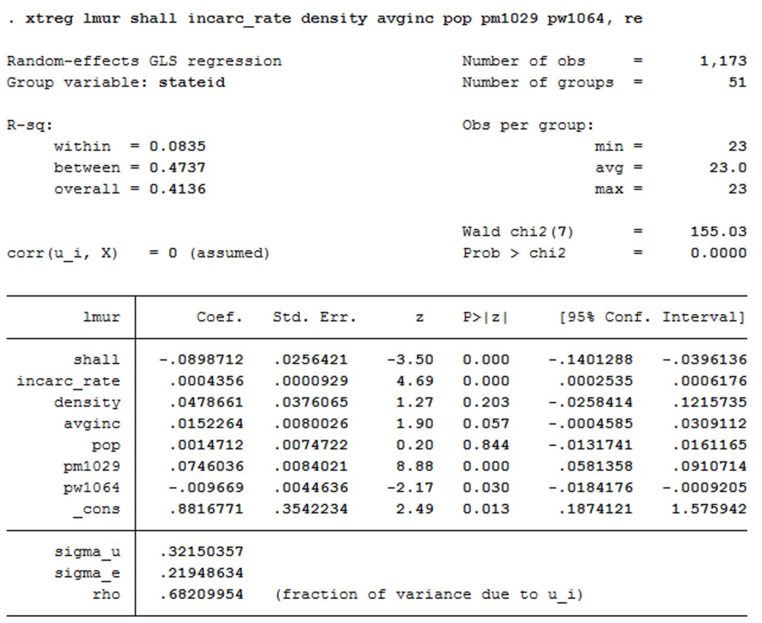
Random Effects Model for murder variable
OUTPUT
The code we used
﻿/* Random effects model */
xtreg lmur shall incarc_rate density avginc pop pm1029 pw1064, re

Slide 25
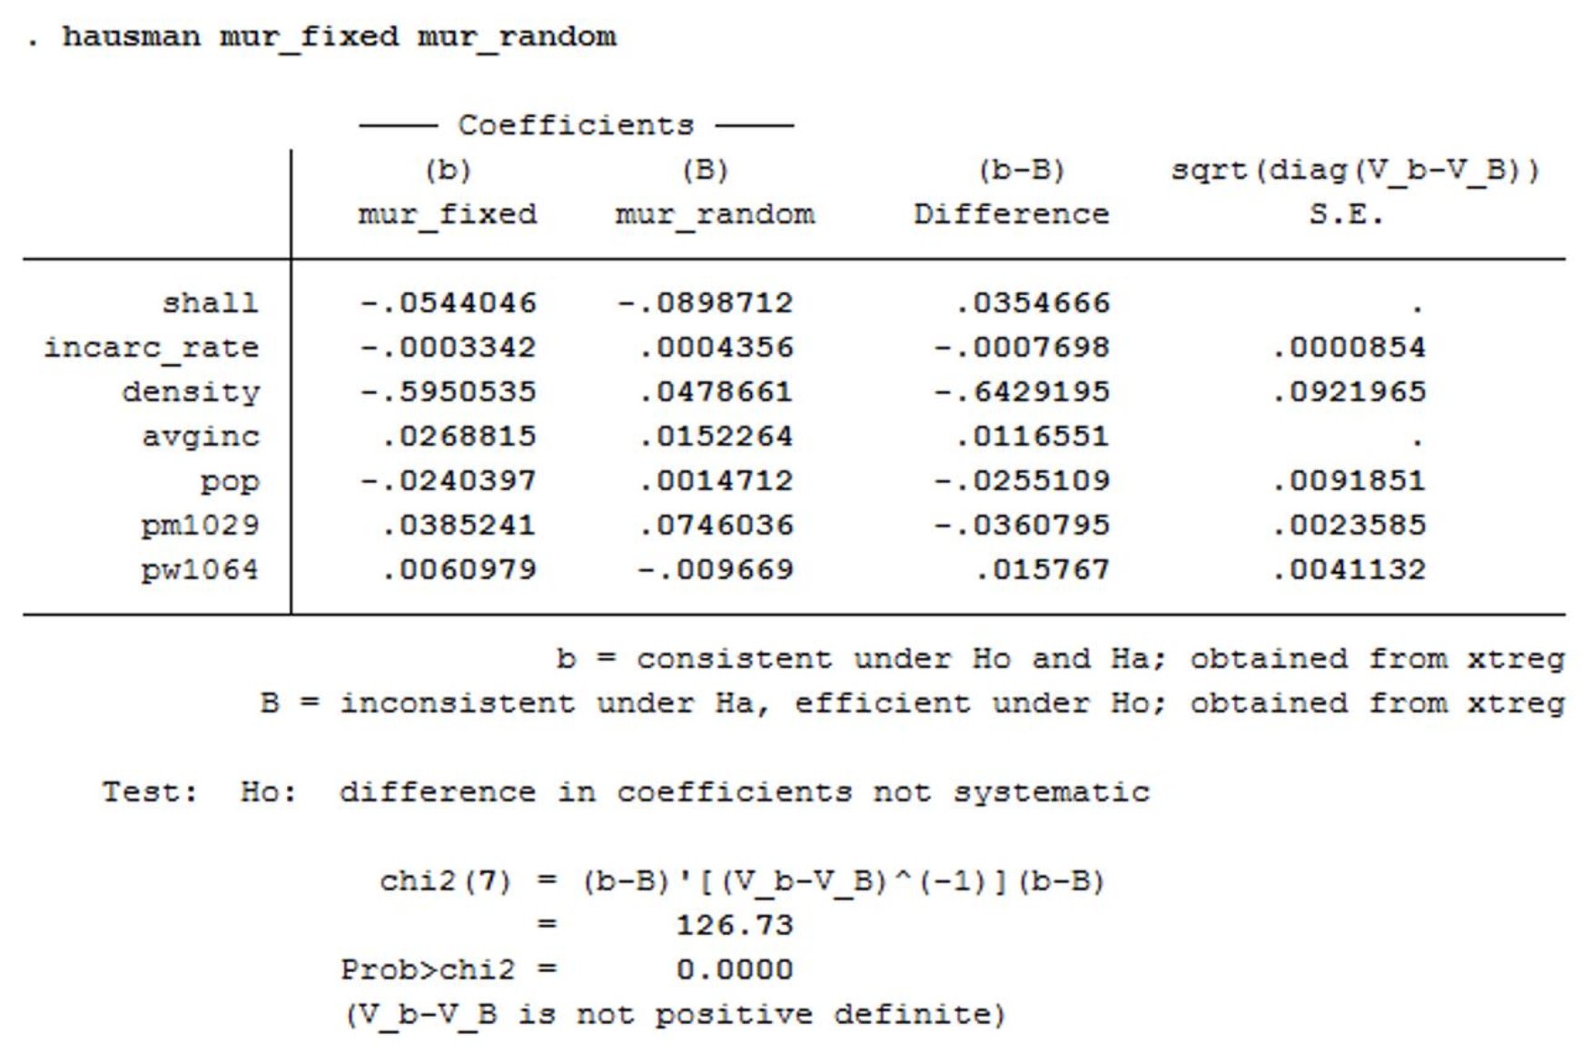
Hausman test for murder variable
OUTPUT
The code we used
/* Hausman test */
xtreg lmur shall incarc_rate density avginc pop pm1029 pw1064, fe
estimates store mur_fixed
xtreg lmur shall incarc_rate density avginc pop pm1029 pw1064, re
estimates store mur_random
hausman mur_fixed mur_random

Slide 26
Thank you

